Slide 1


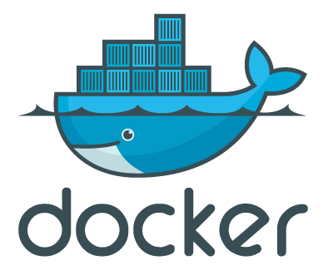

点融网的技术选型与演进
－－以Docker在点融的应用为例
万林涛／Tony Wan
Director of Infra Services

Slide 2

About me
EMC Labs China (2007.07 ~ 2014.01)
Virtualization, cloud computing, distributed systems
Co-author: 《大数据－－战略̂·技术·实践》
点融网 (2014.01 ~ Now)
Director of Infra Services
Dockerize dianrong.com
Private cloud with Docker

Slide 3
Agenda
Why Docker
How we use Docker
Cloud with Docker
Findings
Q&A

Slide 4
Roadmap of Docker@Dianrong
Adopt Docker
Advanced Docker
Cloud with Docker
2014/06
Docker 1.0 released
2015
CI/CD with Docker
Cluster Mgmt with k8s/mesos
2016
Docker-based Cloud

Slide 5
Why Docker?
www.dianrong.com

Slide 6
Background
Migrate to IDC from public cloud (@2014)
Pre-docker Era
VM or Container
The problem
Env for legacy app server

Slide 7
Requirements
Resource sharing – hardware consolidation
Simplify configration
On-demand deployment
Security

Slide 8
VM vs Docker
Lightweight
Sharing more
OS/lib/bin
Apps
Apps
Apps
Apps
Apps
Apps
Libraries
Libraries
Libraries
Guest OS
Guest OS
Guest OS
Libraries
Libraries
Libraries
Host OS/Hypervisor
OS
cgroups, namespace, capabilities, etc.

Slide 9
How we use Docker
www.dianrong.com

Slide 10
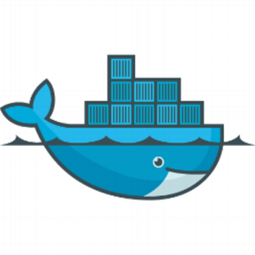
What is Dockerized
Firewall
LB1
LB2
--------------------------------------------------------------------
Frontend
Apps
Other Components
(redis, mongodb, etc.)
Backend
Apps
--------------------------------------------------------------------
…
Databases

Slide 11






CI/CD
Develop
Build
Ship
Run
Build Job #1
QA Env
release
dianrong.com/app:rt67
develop
Build Job #2
dianrong.com/app:latest
Develop Env
master
Build Job #3
dianrong.com/app:prod
Stage Env
Git Server
Jenkins
Docker Registry
Runtimes

Slide 12
Road to CI/CD
war
image
demo/stage
prod

Slide 13
Strategy
Network
Bridge
No multi-host networking with overlay
Storage
Raw devices
Logging
Central logging server
Availability – Business continuity
Service interruption across upgrades of Docker daemon
App/service with HA design

Slide 14
Strategy – Cont’
All-in-one or Runtime-only image
Update image for each release
Only update code while the image remains the same
Env variables or Zookeeper
Configuration management
Why not etcd
Dockerfile: dev or ops
Who takes ownership of Dockfiles
Docker image as deliverables
Security
Management & access control
http://drops.wooyun.org/papers/15892

Slide 15
Cloud with Docker
www.dianrong.com

Slide 16
Alternative solutions
Kubernetes/Mesos …
App cluster?
Keep it simple when you can, not try to mess it up with FANCY arch/tech
OpenStack
Too heavy for us
Capacity to support/maintain/customize
Re-invent the wheel

Slide 17
High-level Architecture
drCloud
ITIL
Security
Center
CMDB

Slide 18
High-level Architecture – Cont’
Docker
Monitor
Docker
Cluster
Manager
Cloud Dashboard
Docker Daemon
API
Docker
Registry
Agent
Jenkins
Message Bus
Git Server
CMDB

Slide 19
Findings
www.dianrong.com

Slide 20
Key factors to a decision
Business
requirements
Cost
Tech
Maturity
Capacity
of
Team
Industry
Trend
Personal preference?

Slide 21
Q & A
www.dianrong.com

Slide 22


我们正在用技术改变金融行业
www.dianrong.com

